Slide 1
“AGRICULTURAL DRONE”
Submitted By
Bhumika D Shetty V CSE
Varsha Bang V CSE
Shreyas N Raj V CSE
Sharanu V CSE
Under the guidance of
Mrs. Vidya R Pai Mrs. Bharathi R
Assistant Professor Associate Professor
Department OF CSE
bmsit&m

Slide 2
CONTENTS
INTRODUCTION
OBJECTIVES
METHODOLOGY
SYSTEM REQUIREMENTS
LITERATURE REVIEW
IMPLEMENTATION DETAILS
CONCLUSION

Slide 3
INTRODUCTION
Unmanned aerial vehicles (UAV), commonly named drones, are small aerial platforms weighing up to 20 kg (50 lbs.).
Drones can be operated in two ways; directly, in which a human has complete control of the vehicle by wireless remote; and autonomously, in which the vehicle is able to control itself and follow a route based on the data from GPS or other sensors.
Ensuring the health of the rural economy has been one of the world’s most challenging issues.
In the more developed countries PRECISION AGRICULTURE has been employed to benefit farmers, increase production and reduce operating costs as well as to enhance labor efficiency, but it is still out of reach for most developing countries.
In recent years, MACHINE LEARNING AND DEEP LEARNING has made remarkable progress and is regarded as the most promising technology for propelling agriculture into the future.

Slide 4
OBJECTIVES
An agricultural drone is an unmanned aerial vehicle used to help optimize agriculture operations , increase crop production , detect any potential or existing disease , pest and weed detection, quality monitoring and overall crop monitoring.
The drone will help the farmers see the field and crops from the sky. This bird's eye view may reveal many pest/weed/irrigation issues etc.
The drone will help the farmer to distinguish between healthy and unhealthy plants ,which may not be clearly visible to naked eye. This will also help them decide better fertilizers , pesticides etc. which will again hype crop productivity

Slide 5
OBJECTIVES
The drone will also act as an assistant to the farmer. Weekly/ daily or even hourly pictures will help farmers understand and connect with their crops better.
All in all the drone will help farmers save a lot of time and get better yield, better clarity with less struggle.
In addition to it, it will also benefit the environment and help preserve it by reducing the intake of fertilizers and pesticides , making their use specific to the requirements of the crops and the area that's affected.

Slide 6
METHODOLOGY
Flying over the field, the drone takes high-resolution pictures with a camera . Based on a measured parameter, these images are captured in different bands from visible (color), near-infrared to infrared spectrum.
The collected images are raw data which requires further interpretation.
Immediately after capturing the image, the images are stored in drone which are then sent to the software where they are tested with different algorithms to check on efficient agriculture .
Drones collect raw data and translate it with algorithms into useful information. Therefore, they can be used for various applications in farming, such as the monitoring of the following parameters:

Slide 7
METHODOLOGY
SPECIES RECOGNITION
SPECIES MANAGEMENT
FIELD CONDITION MANAGEMENT
CROP QUALITY
PLANT DISEASE DETECTION
WEED DETECTION
YIELD PREDICTION

Slide 8
SYSTEM REQUIREMENTS
DRONE : Unmanned aerial vehicles (UAV), commonly named drones, are small aerial platforms weighing up to 20 kg (50 lbs.).
MISSION PLANNER : Mission Planner is a full-featured ground station application for the ArduPilot open source autopilot project.
ANACONDA 3 :Anaconda is a free and open-source distribution of the Python and R programming languages for scientific computing (data science, machine learning applications, large-scale data processing, predictive analytics, etc.), that aims to simplify package management and deployment

Slide 9
LITERATURE REVIEW
Recently we have discussed the emerging concept of smart farming that makes agriculture more efficient and effective with the help of high-precision algorithms.
The mechanism that drives it is Machine Learning — the scientific field that gives machines the ability to learn without being strictly programmed.
It has emerged together with big data technologies and high-performance computing to create new opportunities to unravel, quantify, and understand data intensive processes in agricultural operational environments .
Machine learning is everywhere throughout the whole growing and harvesting cycle. It begins with a seed being planted in the soil — from the soil preparation, seeds breeding and water feed measurement — and it ends when robots pick up the harvest determining the ripeness with the help of computer vision.

Slide 10
conclusion
Every year, Common Agriculture Policy area-based subsidies are controlled using agricultural drone with imagery. The detection accuracy results achieved in this project are not as high as in other projects with object identification networks, nevertheless, they are good enough to lead to the implementation of artificial intelligence using drone and image processing method. Crop recognition has been used before in the agricultural field, but focusing on crop health , weed detection and many more , the project developed in this thesis entails an improvement to the existing weed detector system, in spite of the accuracy obtained . Despite having achieved the objectives set for this thesis, there is still room for improvement This will most certainly improve the quality of the images, thus improving the network’s performance. Through the awareness step of the methodology, enough information was acquired to propose an initial design of the project. This prototype gives an initial idea of how to obtain the images with camera and Python, and an as well as a possible approach to the network training and testing . In the era of precision farming, drones are acting as an essential technology that will take farming to a completely new level. They are a cost-effective way to collect data about various crop conditions in a relatively short period of time. Drones have also shown great potential in the ability to provide sustainable farming, improve yield, and increase overall farm profitability.

Slide 11
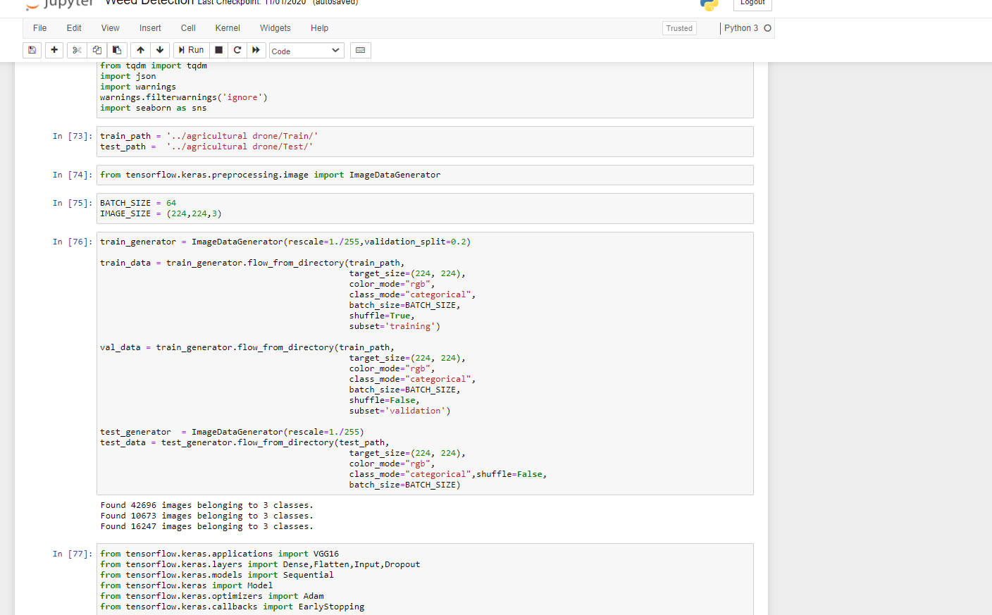
IMPLEMENTATION DETAILS

Slide 12
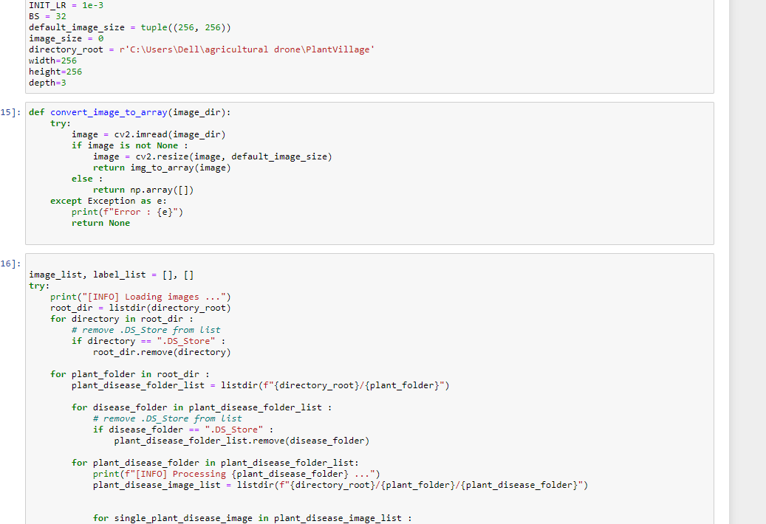
IMPLEMENTATION DETAILS

Slide 13
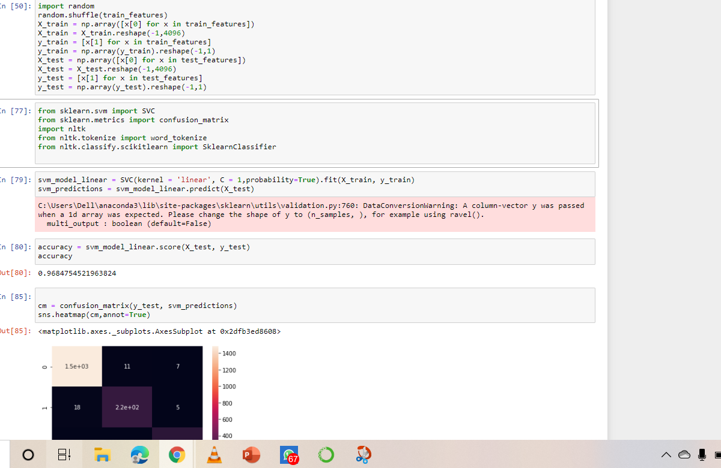
IMPLEMENTATION DETAILS

Slide 14
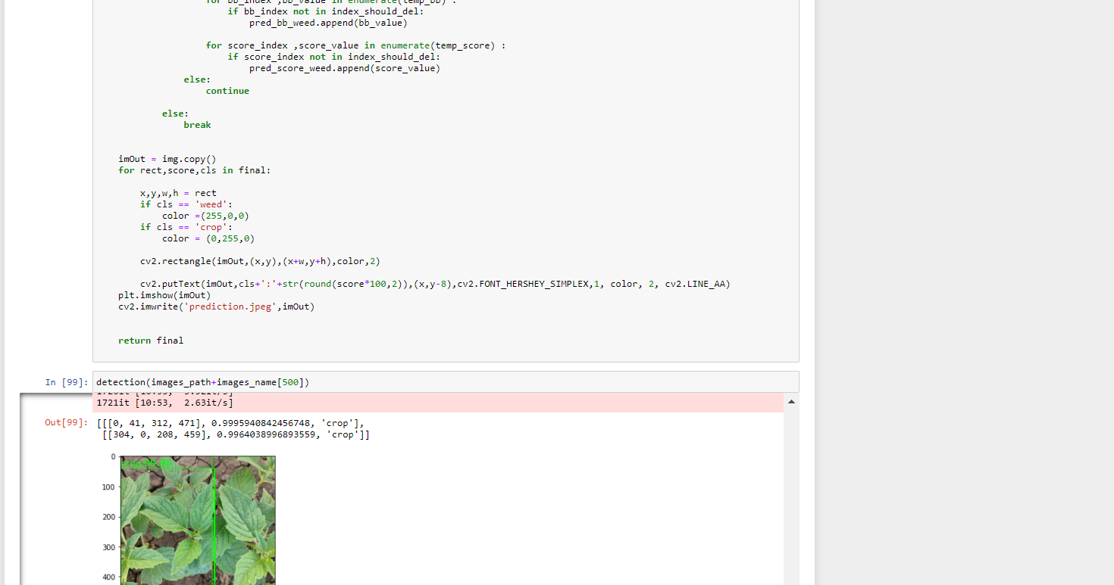
IMPLEMENTATION DETAILS

Slide 15
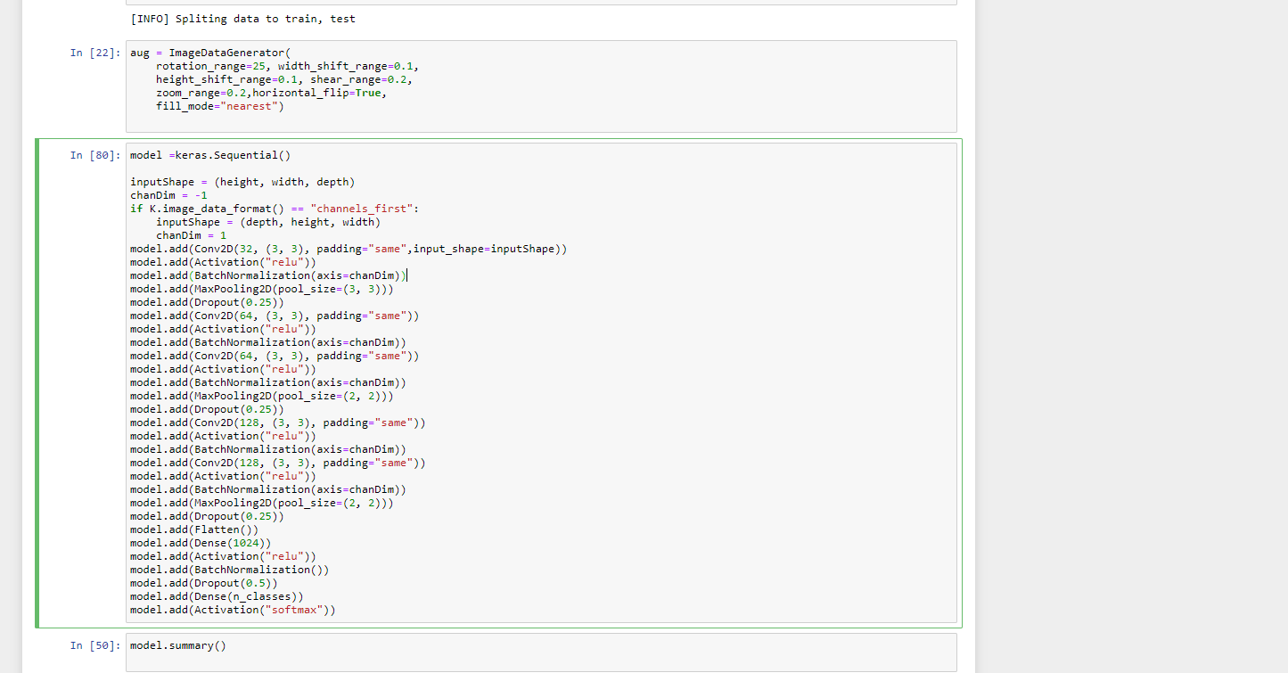
IMPLEMENTATION DETAILS

Slide 16
THANK YOU

